Slide 1
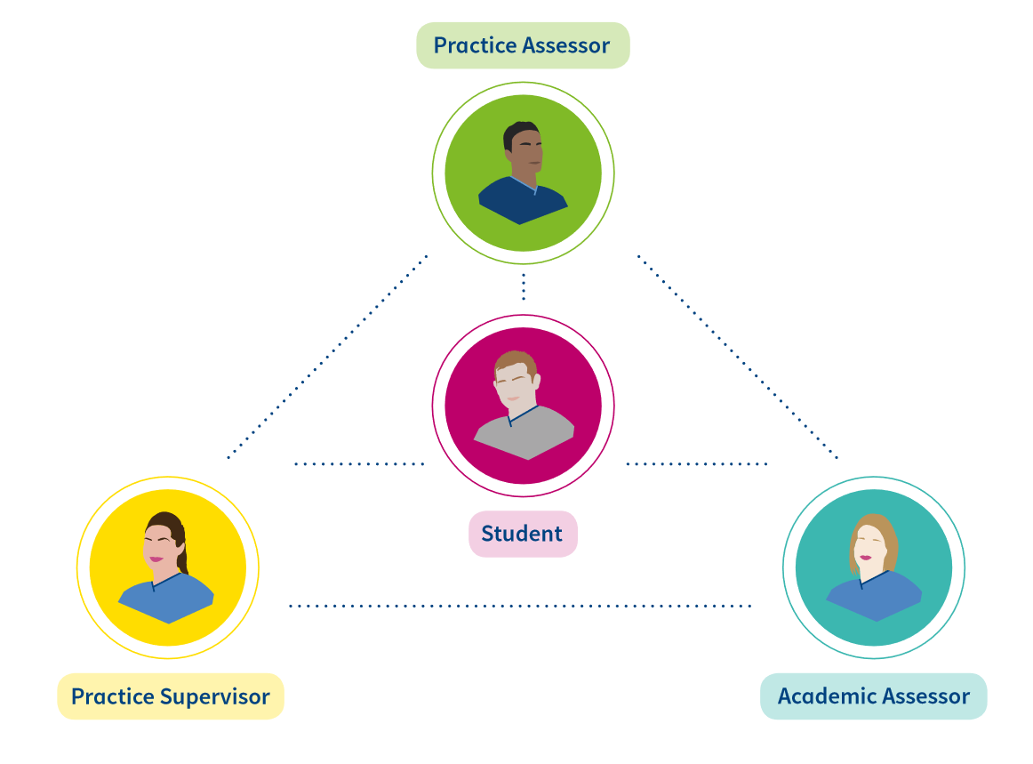
Practice Supervisor and Practice Assessor Transition
​
Slides adapted and reproduced with kind permission from NHS Fife and NHS Tayside
Notes:
Welcome to this PowerPoint presentation which focuses on your transition as a mentor, sign off mentor or practice teacher to the new roles from the Nursing and Midwifery Council to support the new education and training standards which will be implemented across Scotland.​
​
Prior to viewing to this presentation, we would suggest you take some time to review both the new standards from the NMC and the practice supervisor and practice assessor handbook on the Scottish Future Nurse and Midwife Programme Board webpage to inform you of the upcoming changes to your role in supporting students in practice. The links to both these webpages can be found at the bottom of this slide.​
​
Your learning from today and your ongoing development of your roles as a PS/PA will and should be discussed throughout your appraisal with SCN.

Slide 2
Aim
To complete the transition process in preparation for the implementation of new Nursing and Midwifery Council Standards for education and training.
Notes:
The aim of this presentation is to support you to complete the transition process in preparation for the implementation of new Nursing and Midwifery Council Standards for education and training.​
​

Slide 3
Outcomes
Recognise and value the existing skills and experience you bring
Identify the changes in relation to the new NMC standards and proficiencies
Understand your contribution to supporting implementation of these new standards
Identify resources and people who can support you in the transition/implementation
Notes:
The learning outcomes are:​
​
Recognise and value the existing skills and experience you bring​
Identify the changes in relation to the New NMC standards and proficiencies​
Understand your contribution to supporting implementation of these new standards​
Identify resources and people who can support you in the transition / implementation​
Network with colleagues from across healthcare and enable you to share experiences and value existing skills.

Slide 4
Pause
What is your current understanding of the new NMC standards?
Notes:
Before we begin, take 5 minutes to pause and reflect on your current understanding of the new NMC Standards. When you are ready, restart the presentation to move onto the next slide.

Slide 5
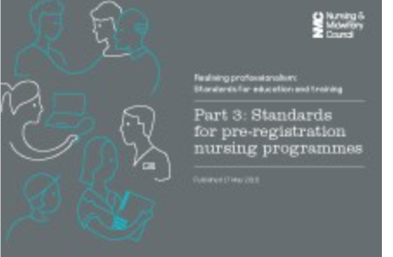
New Standards
2 sets of standards
Future Nurse
Realising professionalism
Notes:
Having completed the activity on the last slide, you may be aware that there are 2 sets of standards from the NMC​
​
The Future nurse: Standards of Proficiency for registered nurses and also the Standards of Proficiency for Midwives; and also the Realising professionalism: Standards for education and training. Together, these provide a complete picture of:​
​
what nurses and midwives need to know and be able to do, by the time they register with the NMC ​
what universities and their practice placement partners must provide when delivering education and training courses.​
​
In addition, there are also a set of Standards for: ‘Return to Practice’ and for ‘Prescribing Programmes’. There is a link to these standards and other useful resources at the end of the presentation.

Slide 6
Previous Standards – 4 domains
Nursing
Midwifery
Notes:
With the publication of these new standards there are a number of changes that differ from the previous standards.​
​
For example within the previous standards in both nursing and midwifery, students were assessed on four domains. However with the new standards all nursing students will be assessed on seven platforms and for midwifery students, there are 6 domains. This is why it is so important you take some time to familiarise yourself with the new standards.

Slide 7
New Standards
Nursing 7 Platforms:
Being an accountable professional
Promoting health and preventing ill health
Assessing needs and planning care
Providing and evaluating care
Leading and managing nursing care and working in teams
Improving safety and quality of care
Coordinating care
Midwifery 6 Domains:
Being an accountable, autonomous, professional midwife
Safe and effective midwifery care: promoting and providing continuity of care and carer
Universal care for all women and newborn infants
Additional care for women and newborn infants with complications
Promoting excellence: the midwife as colleague, scholar and leader
The midwife as skilled practitioner
Notes:
This slide shows the 7 platforms for nurses and the 6 domains for midwives and they are important to understand because they:​
​
represent the knowledge, skills and attributes that all registered nurses and midwives must demonstrate when caring for people​
reflect what the public can expect nurses and midwives to know and be able to do in order to deliver safe, compassionate and effective care.​
provide a benchmark for nurses and midwives from the European Economic Area, EU and overseas wishing to join the register.​
provide a benchmark for those who plan to return to practice after a period of absence.​
​
The nursing proficiencies are grouped under seven platforms and followed by two annexes. Together, these reflect what we expect a newly registered nurse to know and be capable of doing safely and proficiently at the start of their career.​
​
Key components of the roles, responsibilities and accountabilities of registered nurses are described within these platforms and they form the basis of the new pre-registration nursing practice assessment document - previously known as the OAR. Midwifery PAD in development. We would encourage to take time to access the PAD and become familiar with it. ​
​
The nursing platforms are:​
Platform 1 – Being an accountable professional​
Registered nurses act in the best interest of people, putting them first and providing nursing care that is person centred, safe and compassionate. They act professionally at all times and use their knowledge and experience to make evidence-based decisions about care. They communicate effectively, are role models for others and are accountable for their actions. Registered nurses continually reflect on their practice and keep abreast of new and emerging developments in nursing, health and care​
​
Platform 2-Promoting health and preventing ill health​
Registered nurses play a key role in improving and maintaining the mental, physical and behavioural health and well being of people, families, communities and populations. They support and enable people at all stages of life and in all acre settings to make informed choices about how to manage health challenges in order to maximise their quality of life and improve health outcomes. They are actively involved in the prevention of and protection against disease and ill health and engage in public health, community development and global health agendas and in the reduction of health inequalities​
​
Platform 3- Assessing needs and planning care​
Registered nurses priorities the needs of people when assessing and reviewing their mental , physical, cognitive, behavioural, social and spiritual needs. They use information obtained during assessments to identify the priorities and requirements for person-centred and evidence-based nursing interventions and support. They work in partnership with people to develop person-centred care plans that take into account their circumstances, characteristics and preferences​
​
Platform 4 – Providing and evaluating care​
Registered nurses take the lead in providing evidence-based , compassionate and safe nursing interventions. They ensure that care they provide and delegate is person-centred and of a consistently high standard. They support people of all ages in a range of care settings. They work in partnership with people, families and carers to evaluate whether care is effective and the goals of care have been met in line with their wishes preferences and desired outcomes​
​
Platform 5- Leading and managing nursing care and working in teams​
Registered nurses provide leadership by acting as a role model for best practice in the delivery of nursing care. They are responsible for managing nursing care and are accountable for the appropriate delegation and supervision of care provided by others in the team including lay carers. They play an active and equal role in the interdisciplinary team, collaborating and communicating effectively with a range of colleagues.​
​
Platform 6 – Improving safety and quality of care​
Registered nurses make a key contribution to the continuous monitoring and quality improvement of care and treatment in order to enhance health outcomes and people’s experience of nursing and related care. They assess risks to safety or experience and take appropriate action to manage those, putting the best interests, needs and preference of people first​
​
Platform 7 – Coordinating care​
Registered nurses play a leadership role in coordinating and managing the complex nursing and integrated care needs of people at any stage of their lives, across a range of organisations and settings. They contribute to processes of organisational change through an awareness of local and national policies​
​
The standards of proficiency for midwives are grouped under six Domains. The NMC state these Domains inter-relate and build on each other, and should not be seen separately. Together these reflect what we expect a new midwife to know, understand and be capable of doing safely and proficiently, at the start of their career. ​
​
The Domains are:​
1. Being an accountable, autonomous, professional midwife ​
2. Safe and effective midwifery care: promoting and providing continuity of care and carer ​
3. Universal care for all women and newborn infants ​
A. The midwife’s role in public health, health promotion and health protection ​
B. The midwife’s role in assessment, screening and care planning ​
C. The midwife’s role in optimising normal physiological processes and working to promote positive outcomes and prevent complications ​
4. Additional care for women and newborn infants with complications ​
A. The midwife’s role in first line assessment and management of complications and additional care needs ​
B. The midwife’s role in caring for and supporting women and newborn infants requiring medical, obstetric, neonatal, mental health, social care, and other services ​
5. Promoting excellence: the midwife as colleague, scholar and leader ​
A. Working with others: the midwife as colleague ​
B. Developing knowledge, positive role modelling and leadership: the midwife as scholar and leader​
6. The midwife as skilled practitioner

Slide 8
Nursing Skills – Annexes A and B key outcomes
Annexe A:
Specifies the communication and relationship skills required.
Annexe B:
Specifies the nursing procedures the registered nurse will be able to demonstrate safely at the point of registration.
Notes:
In nursing, there are also two annexes in additon to the 7 platforms and they are shown on this slide. They are:​
​
Annexe A: Communication and relationship management skills​
​
Effective communication is central to the provision of safe and compassionate person-centred care. Registered Nurses in all fields of nursing practice must be able to demonstrate the ability to communicate and manage relationships with people of all ages with a range of mental, physical, cognitive and behavioural health challenges.​
​
Skills outlined in Annexe A apply to all registered nurses from all fields of practice. Registered nurses must be able to demonstrate these skills to an appropriate level for their intended fields of practice. They include:​
​
Motivational interview techniques​
Solution focused therapies​
Talking therapies​
De-escalation strategies and techniques​
Play therapy​
Distraction and diversion strategies​
Positive behaviour support approaches​
Appreciative enquiry​
​
Annexe B: Nursing procedures​
Registered nurses in all fields of practice must demonstrate the ability to provide nursing intervention and support for people of all ages who require nursing procedures during the processes of assessment, diagnosis, care and treatment for mental, physical, cognitive and behavioural health challenges. Where people are disabled or have specific cognitive needs it is essential that reasonable adjustments are made to ensure that all procedures are undertaken safely.​
​
Procedures for example​
Take ,record and interpret vital signs manually and via technological devices​
Undertake veneputure and cannulation and blood sampling, interpreting normal and common abnormal blood profiles and venous blood gases​
Set up and manage ECG​
Manage and monitor blood transfusions​
Manage and interpret cardiac monitors, infusion pumps, blood glucose monitors and other monitoring devices​
​
The procedures within annexes A & B apply to all registered nurses but the level of expertise and knowledge required will vary depending on their chosen field of nursing practice

Slide 9
Venepuncture
Chest auscultation
Play Therapy
Health Promotion
Notes:
Mentors, sign off mentors and practice teachers should be reassured that although there are changes within new standards you have the skills and knowledge to support these learners and there is no requirement for you to gain new skills if they are not used within your practice environment.

Slide 10
Pause
Take 5 minutes to revisit the standards and to consider the opportunities available for students in your areas?
Notes:
Take 5 minutes to consider the opportunities available for students in your areas. When you return to your clinical areas, consider having a discussion with colleagues to explore this further. Remember you already have the knowledge and expertise to support students to achieve their new proficiences.

Slide 11
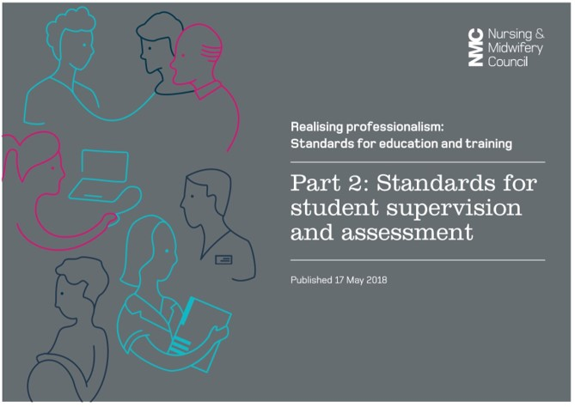
Changing Roles
Practice Supervisor
Practice Assessor
Academic Assessor
Notes:
With the introduction of the new standards roles will be changing.
Currently:​
​
All mentors, sign off mentors and practice teachers support learning in practice by:​
​
Providing support and guidance to the student when learning new skills or applying new knowledge​
Acting as a resource to the student to facilitate learning and professional growth​
Directly managing the students learning in practice to ensure public protection ​
​
The new Standards for Student Supervision and Assessment set out expectations for the learning, support and supervision of students in the practice environment. They also set out how students are assessed for theory and practice learning. The new roles to support this process are the practice supervisor, practice assessor and academic assessor.​
​
The structure of the standards follow and support the student journey by stating:​
What needs to be in place to deliver safe and effective learning experiences for nursing and midwifery students in practice.​
The principles of student supervision in the practice environment and the role of the practice supervisor.​
The roles of the practice assessor and academic assessor.

Slide 12
Practice Supervisor
As per NMC SSSA document ‘All NMC registered nurses and midwives are capable of supervising students’
Students can also be supervised by other registered health and social care professionals.
Will support learning and supervise students in practice to meet programme proficiencies.
Will contribute to student assessments which will be recorded in the Practice Assessment Document.
Notes:
Roles and Responsibilities of Practice Supervisor are:​
​
As a practice supervisor, you are expected​
Serve as a role model for safe and effective practice in line with their code of conduct​
Support learning in line with their scope of practice to enable the student to meet their proficiencies and programme outcomes​
Support and supervise students, providing feedback on their progress towards ,and achievement of, proficiencies and skills​
Have current knowledge and experience of the area in which they are providing support, supervision and feedback​
Receive ongoing support to participate in the practice leaning of students​
​
In Scotland, a student will have a nominated practice supervisor who will actively support students and address student outcomes however, during a placement a student may have more than one practice supervisor and all nurses and midwives in the team have a role in contributing to effective practice learning in accordance with the code. ​

Slide 13
Practice Assessor
Nominated practice assessor for a placement or series of placements
Practice assessors must be nurses, midwives or specialist community public health nurse (SCPHN)
Collaboration with practice supervisors and academic assessors key to role
Conduct and record objective evidence-based assessments of student achievement
Informed by direct observation, feedback from Practice Supervisors and student self-reflection.
Notes:
Practice Assessor Responsibilities​
Practice assessor conduct assessments to confirm student achievement of proficiencies and programme outcomes for practice learning​
Assessment decisions by practice assessors are informed by feedback sought and received from practice supervisors​
Practice assessor make and record objective evidence-based assessments on conduct, proficiency and achievement, drawing on student records, direct observation student self reflection and other resources​
PA maintain current knowledge and expertise relevant for the proficiencies and programme outcomes they are assessing​
A nominated PA works in partnership with nominated academic assessor to evaluate and recommend the student for progression for each part of the programme, in line with programme standards and local and national policies​
To ensure sufficient opportunities for the PA to periodically observe the student across environments in order to inform decisions for assessment and progression​
Sufficient opportunities for PA to gather and coordinated feedback from practice Supervisors, any other practice assessors, and relevant people , in order to be assured about their decisions for assessment and progressions​
PA have an understanding of the student’s learning and achievement in theory​
Communication and collaboration between practice and academic assessors is scheduled for relevant points in programme structure and student progression​
PA are not simultaneously the practice supervisor and academic assessor for the same student.​
PA for students on NMC approved prescribing programmes support learning in line with NMC Standards for prescribing programmes.

Slide 14
Academic Assessor
The academic assessor will be a registered nurse, midwife, or specialist community public health nurse (SCPHN) based within the approved education institution.
Academic assessors are assigned to a student for part of a programme.
The role of assessing a student for progression is the responsibility of the academic and practice assessors, working together.
Notes:
Academic Assessor (AA) Responsibilities​
AA collate and confirm student achievement of proficiencies and programme outcomes in the academic environment for each part of the programme.​
AA make and record objective, evidence-based decisions on conduct, proficiency and achievement and recommendations for progression, drawing on student records and other resources​
AA maintain current knowledge and expertise relevant for the proficiencies and programme outcomes they are assessing and confirming​
Nominated AA works in partnership with the nominated PA to evaluated and recommended the student for progression for each part of the programme, in line with programme standards and local and national policies​
AA have an understanding of the student’s learning and achievement in practice​
Communication and collaboration between academic and practice assessors is scheduled for relevant points in programme structure and student progression​
AA are not simultaneously the practice supervisor and practice assessor for the same student.​
​
Remember, the three new roles within the standards are to provide the opportunity for more robust assessment. Also, the new standards acknowledge the supervisory roles of other health and care professionals and the opportunities students have to learn from a range of relevant people in the practice learning environment including service users, registered and non-registered individuals and other students as appropriate.

Slide 15
Pause
A student has been allocated to your practice area
How do you see the roles of practice supervisor and assessor working within your practice learning environment?
How would you in your role as a practice supervisor/assessor communicate with the academic assessor?
Notes:
Now that you are aware of the changes the new standards require, take some time to think about how you are going to apply these in practice. Imagine two students have been allocated to your practice area.​
​
How do you see the roles of practice supervisor and assessor working within your practice learning environment?​
How would you in your role as a practice supervisor/assessor communicate with the academic assessor?

Slide 16
Further reading:
Scottish Future Nurse and Midwife Programme Board - https://www.nes.scot.nhs.uk/education-and-training/by-discipline/nursing-and-midwifery/practice-education/scottish-future-nurse-and-midwife-programme-board.aspx
NMC Standards for Nurse – https://www.nmc.org.uk/standards/standards-for-nurses/

