Slide 1
Dental Vocational Training (DVT )
2023 -2024
Recruitment & Selection Process
Jimmy Boyle VT Lead
Billy Cameron Assistant Dean West
Calum Cassie Assistant Dean East/North
Fiona McFadzean VT adviser
Ed Bateman VT adviser - Rural

Slide 2
Process Dates and Order
Visitation opens 19th May 2023 (10 am)
Contact practices 19/5/23 - 5/6/23 (As many as you like!)
  Visitation may or may not be conducted face to face
Select 7 and rank them in preference
[Trainers go through same process]
Submit your preferences by 10 am 05/6/23
Results released 07/6/23 (10am) – 48hours to accept or reject
Clearing will commence 9/6/20 (by 5pm)

Slide 3
THE NUMBERS GAME
Number of training posts, and number of applicants

Slide 4
How Matching works & Securing an Appointment
All matching appointments will be via Oriel and will occur only at the end of the visitation period.
The submission deadline will be absolute
Clearing appointments outside of matching must be confirmed by emails from both parties.
For 2023/24 – Remote/Rural Direct appointments

Slide 5
Dental Vocational Training in a Rural Setting
Consider a change of scene for your training??

Slide 6
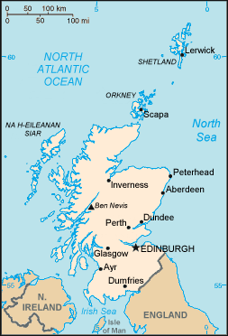
This Photo by Unknown Author is licensed under CC BY-SA

Slide 7
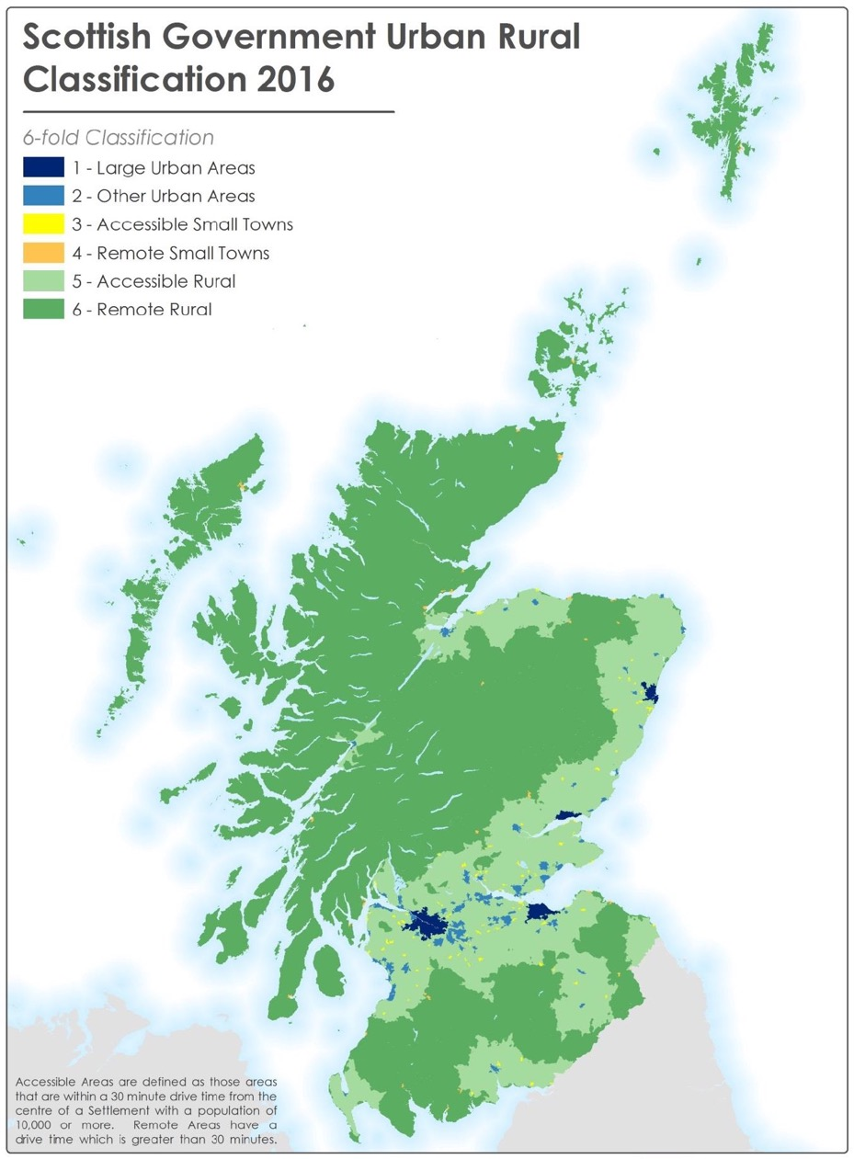

Slide 8
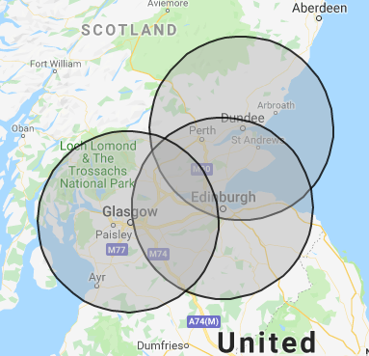
2023

Slide 9
Why me??
Confirmed Glaswegian
VDP in Glasgow
Now settled in the North of Scotland

Slide 10
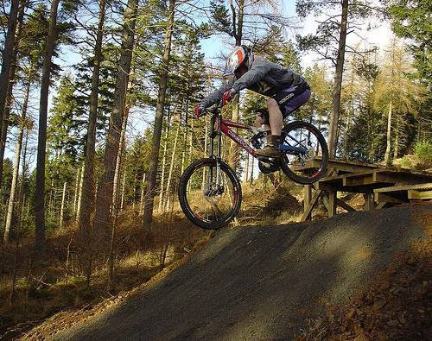
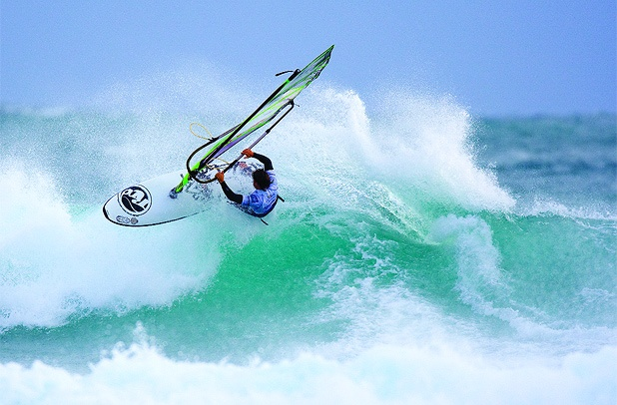
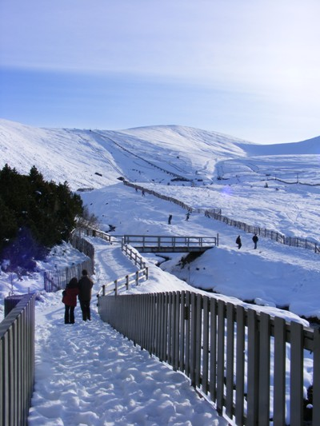
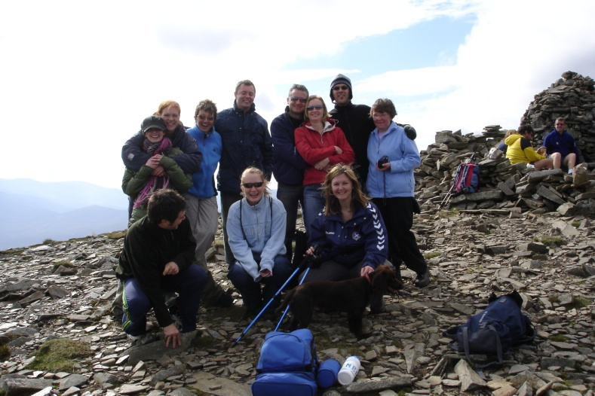
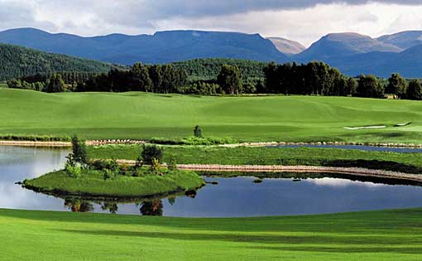
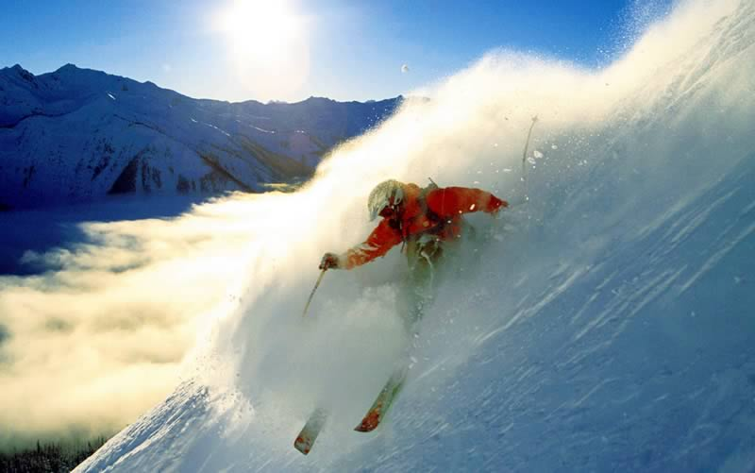
Outdoor Pursuits
Hillwalking
Mountain climbing
Mountain biking
Water sports
Golf
Skiing / snowboarding

Slide 11
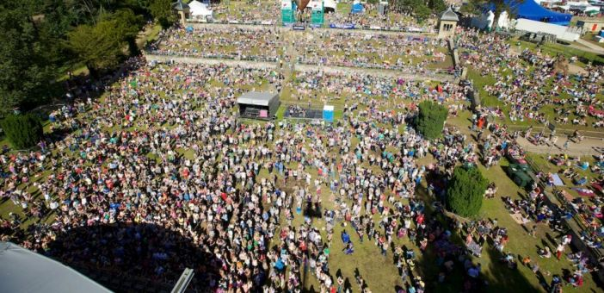
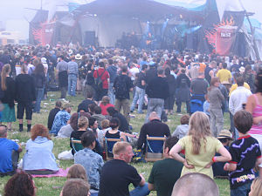
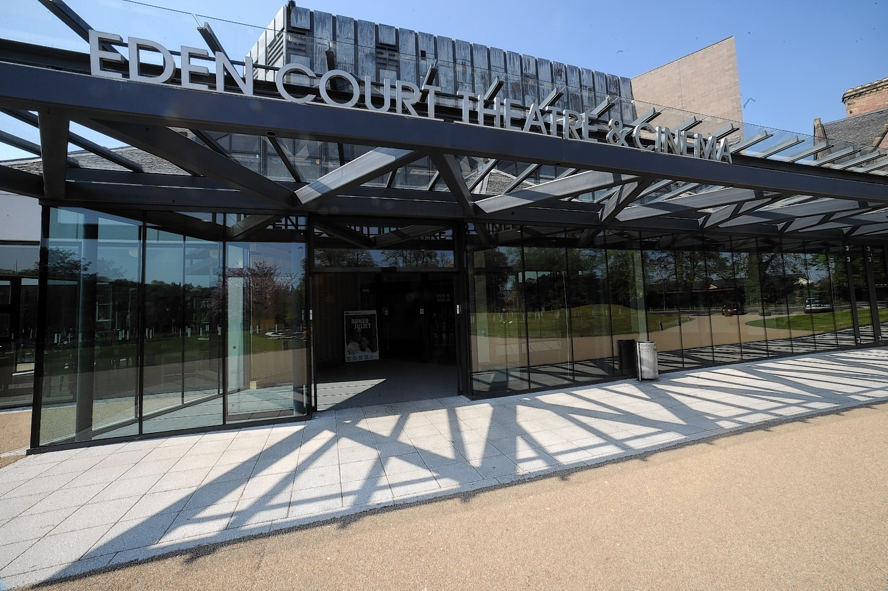
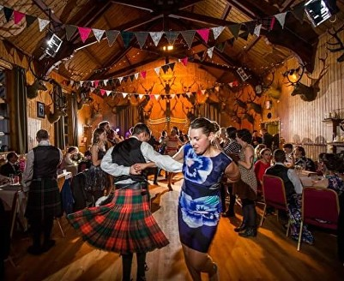
Great local communities with vibrant culture and social opportunities

Slide 12
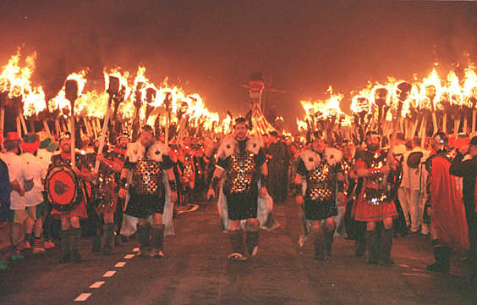
Friday night in Lerwick

Slide 13
Recently announced incentive for VDPs
Scottish Statement of Dental Remuneration
PCA(D)(2022)2 Amendment No 155
Scottishdental.org
£12,500.00/£7,500.00

Slide 14
Rural VT
Pros and Cons
Different lifestyle – more relaxed, and different patient relationships.
Sometimes less easy to refer!
Greater opportunities to tackle complex treatments while well supported
Closer links with other healthcare professionals in smaller communities i.e. More joined up working , you know who to speak to!

Slide 15
Rural VT
Less easy to socialise with, and gain support from, your peer group
Balanced by strong support from network of other Rural dentists/therapists and adviser
NB Rural posts are often easier to secure – remember competitive nature of recruitment!
WE HAVE DELIBERATELY MADE RECRUITMENT EASIER FOR RURAL POSTS.
Excellent addition to your CV for future positions

Slide 16
Other allowances are available in certain rural areas e.g. remote Areas Allowance, enhanced Rural Allowance for CPD

Slide 17
What IS remote??
Do you need to live away from home?
Would you consider a post 150 miles away?
Would you consider a post an hour’s drive away?

Slide 18
Is it for you?
How adaptable are you?
How important are your current ties? (partners/parents/communities/friends)
How competitive do you want recruitment to be??
What kind of lifestyle and training experience do you want for your year?
Where do you come from – and where are you going?
Remember – it’s only 1 year (??) – but it just might be the best decision you ever made!

Slide 19
Remote and Rural Contacts –Please Get in Touch
NHS Ayrshire and Arran Peter.Ommer2@aa.nhs.scot
NHS Borders adelle.mcelrath@borders.scot.nhs.uk
NHS Dumfries and Galloway valeriewhite@nhs.scot
NHS Grampian jiloya@nhs.scot (Jonathan Iloya)
NHS Highland johnlyon3@nhs.scot
NHS Orkney jay.wragg@nhs.scot
NHS Shetland antony.visocchi@nhs.scot
NHS Western Isles colinrobertson@nhs.scot

Slide 20
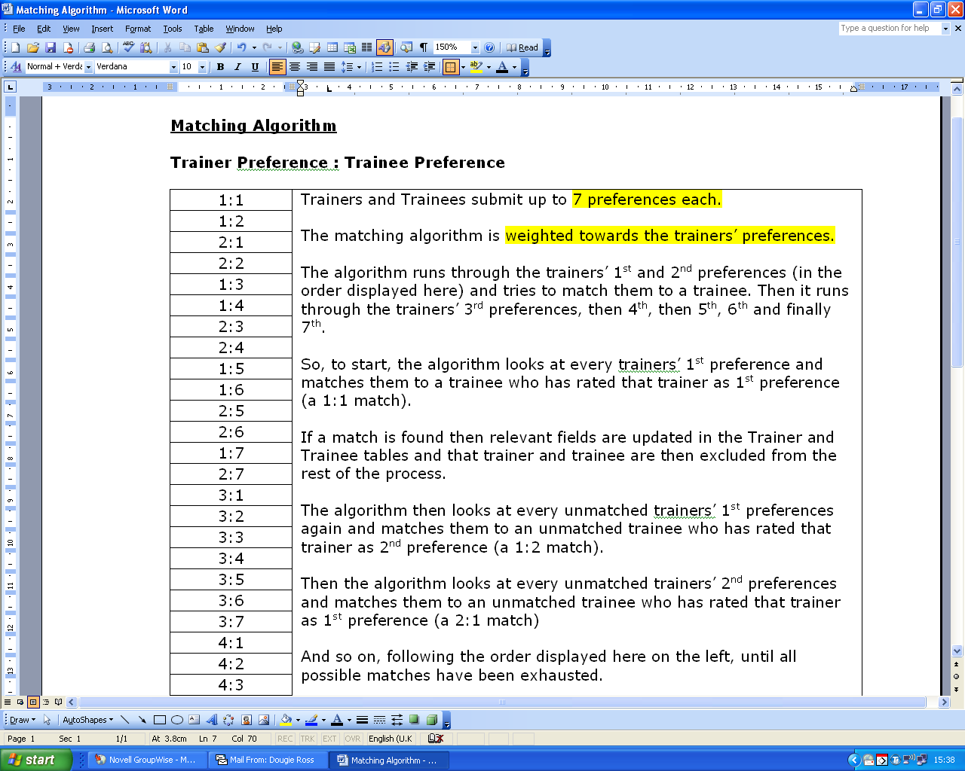

Slide 21
The Clearing Process for DVT
“First come first served”
Likely to be a fairly large number in clearing
Competition would suggest this round will be over quickly
What if you still don’t get a post?

Slide 22
How do I contact trainers ?
Trainers will have different ways of wishing to be contacted. Look at the method of contact listed on their prospectus and adhere to this.
Trainers will all conduct recruitment differently to suit their practice, e.g. some trainers will hold open sessions, some will ask for CVs to be sent to them and they will shortlist those to be invited to interview.

Slide 23
C.V.s

Slide 24
Where to find guidance
From the NES Dental Recruitment Team:
Email – dental.recruitment@nes.scot.nhs.uk
Website - https://www.nes.scot.nhs.uk/recruitment/dental-recruitment.aspx

Slide 25
Seeking a VT post
Be professional! Your interactions with Trainers will make an impression on them and may influence their judgement of how you would be if you were to work in their practice e.g. if you are no longer able to keep an appointment let them know
This is a highly competitive process. Participating in the visitation period is not a guarantee that you will get a job. You will have to compete against other candidates and make a good impression on Trainers at appointments.
Take time to think about how to present yourself and what you want a Trainer to know about you.
Dental Recruitment team are there to support you through the recruitment process and can be emailed throughout for advice and support
Dental.recruitment@nes.scot.nhs.uk

Slide 26
Top tips
1/ Keep an eye on important dates and times
2/ Remember the competitive nature of this process
3/ Be professional at all times – EVERYTHING is an interview
4/ If at first you don’t succeed….

Slide 27

Using the trainer PROFILE INFORMATION
Guidance available via the Dental Recruitment team

Slide 28
Process
Visit the Dental VT Information Site
  The link to this will be provided to trainees via email when Visitation opens on 19th May 2023
You will be able to search for Trainers by region, type (DVT), direct appointments and left handed suitability.
  You will also be able to search by a Trainer's name if this is known to you

Slide 29
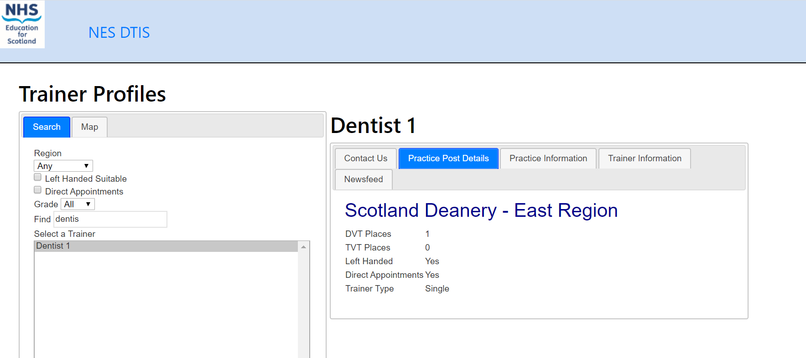

Slide 30
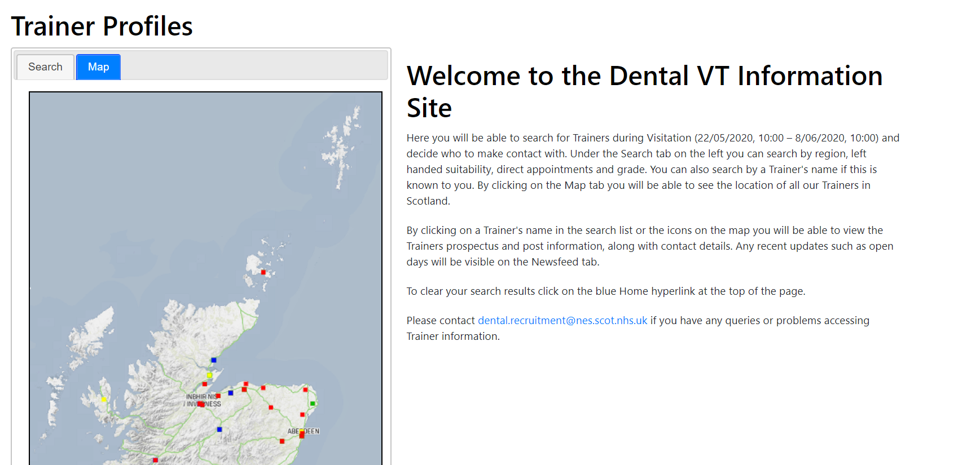

Slide 31
View a Trainer’s Page
Pay particular attention to the Practice Post Details tab
Are they a joint trainer? Are they a shared trainer?
Do they have particular interests
Do they have provision for left handed/accessibility needs?

Slide 32
Bookmark a Trainer
Use the bookmark button you will see on their profile
Their activity will now appear on your wall – just like facebook or twitter (but not really!)

Slide 33
Contact a Trainer
View the Trainer’s Contact Us tab – pay attention to the last section telling you how they wish to be contacted
If the Trainer has supplied an email address ensure you attached your CV when emailing.

Slide 34
Entering Preferences
Preferences entered ONLY via the Oriel Recruitment System, where you applied – no matches can be made independently
https://www.oriel.nhs.uk/web

Slide 35
SELECTIONs
You have up to 7 options – please use them. Don’t select anyone you don’t want to work with!
You cannot equally rank trainers. The list works 1 – 7, in order
Always SAVE before you log out
You can return and change the list as often as you want before the deadline.
Full guidance on the preferencing process will be provided by the Dental Recruitment team prior to visitation opening.

Slide 36
Top tips
1/ Use your selections – you have seven
2/ Don’t put a trainer on your list if you wouldn’t work with them
3/ Do your research – the perfect practice isn’t just about location
4/ Find out what will appeal to trainers
5/ Contact trainers the way they want to be contacted
6/ First impressions matter

Slide 37
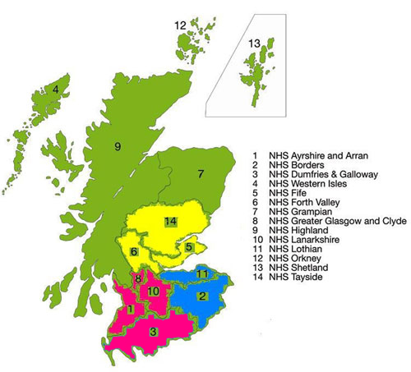
A Fair System?
What bothered applicants in
previous years?

Slide 38
Timing
☹ “….. It would be better if we could do it at the end of May / start of June when exams are over……
"There was not enough time between the actually list of trainers being published and the practice visit period, especially when some students had extremely busy university timetable between these two events.”
“The 3 week interview period is too long…. It is very stressful.”

Slide 39
The matching/ appointing system
“Very Competitive and most trainers interview candidates purely based on their CV which sometimes can be very misleading as interviewing everyone will make it fair to both the trainer and the candidate.”
☹ “It should be made clear if trainers are allowed to disclose whether or not they are putting you on their list before submitting it, and this should be standardised so that everyone does so therefore all applicants are in the same position.”
☹ “Too much travelling to different places.”

Slide 40
Matching – the harsh facts
✓ “Potential of number 2 choice by a trainer dropping right down the list.”
✓ "The trainer and the trainee seem to have no idea how high on each others lists they are.”
✓ “Risk of not matching with a trainer you would like to work most with …”
✓ “I don’t know where I stand with practices, they may interview 50 people and …. this makes it difficult to decide who to put on mine.”
✓ “No guarantee of jobs …...”

Slide 41

Fairness
“People going behind others’ backs and telling who is on their list and who is not. Some people already know they will be a trainer’s number one choice so it is a waste of a vote for others who may put this trainer as their number one.”
“….. Also some trainers tell people that they are their number 1 choice which defeats the purpose of this process.”

Slide 42
Mis-information
☹ “It can lead to a great deal of rumour spreading between classmates.”
☹ “People make matches outwith the system.”

Slide 43
Non-Scottish students taking some places
☹ “Scotland graduates should be given preference for their VT as there is just enough posts for us.
☺ “Thank you very much for a job in Scotland”

Slide 44
Top Tips!
1/ Don’t listen to the rumour mill
2/ Trust the system – it’s designed to be fair
3/ Use the visitation period, and see as much as you can – dental schools have bent over backwards to make this as easy as possible

Slide 45
Any Questions?
Wishing you all the best for the recruitment process!

