Slide 1

Delivering The Forensic Matrix & Low Intensity Psychological Interventions in Forensic Services in Scotland
Dr Sarah Weldon
Clinical Psychologist & Principal Educator NES and NHS
&
Ms Patricia Cawthorne
Consultant Nurse
SoFMH

Slide 2
Introduction
In keeping with Scottish Parliamentary Paper and Key Government Drivers, the Forensic Matrix Working Group was formed in Scotland with a National Remit.
This allowed for the Forensic Match Stepped Care Model to be developed
Psychological Therapy Protocols, devised to meet specific needs of population and allow for a treatment pathway, were developed and implemented
NES & SoFMH developed Low Intensity Training to meet clinical need and increase access to psychological therapy in forensic settings.

Slide 3
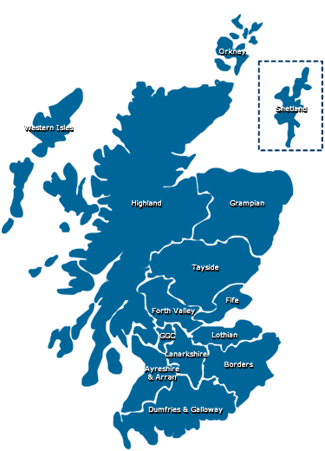
Map of Scotland

Slide 4

Key Drivers
Mental Health in Scotland: A Guide to delivering evidence-based Psychological Therapies in Scotland – The Matrix, 2011 (NHS Education for Scotland and The Scottish Government, 2011 and 2015). IAPT and implementation of ‘matched stepped care’ model​
Mental Health Strategy for Scotland 2017 – 2027 – a 10 year vision (Scottish Government)​
Rights, Relationships and Recovery: Refreshed: The Report of the National Review of Mental Health Nursing in Scotland action plan (The Scottish Government, 2010)​
Realising Potential (The Scottish Government, 2010)
Notes:
The Matrix (2015) A Guide to Delivering Evidence-Based Psychological Therapies in Scotland
The Psychological Therapies 'Matrix' is a guide to planning and delivering evidence-based Psychological Therapies within NHS Boards in Scotland. The Matrix is published by NES, in partnership with the Scottish Government. It provides a summary of the information on the current evidence base for various therapeutic approaches, guidance on well functioning psychological therapies services and advice on important governance issues.

Slide 5

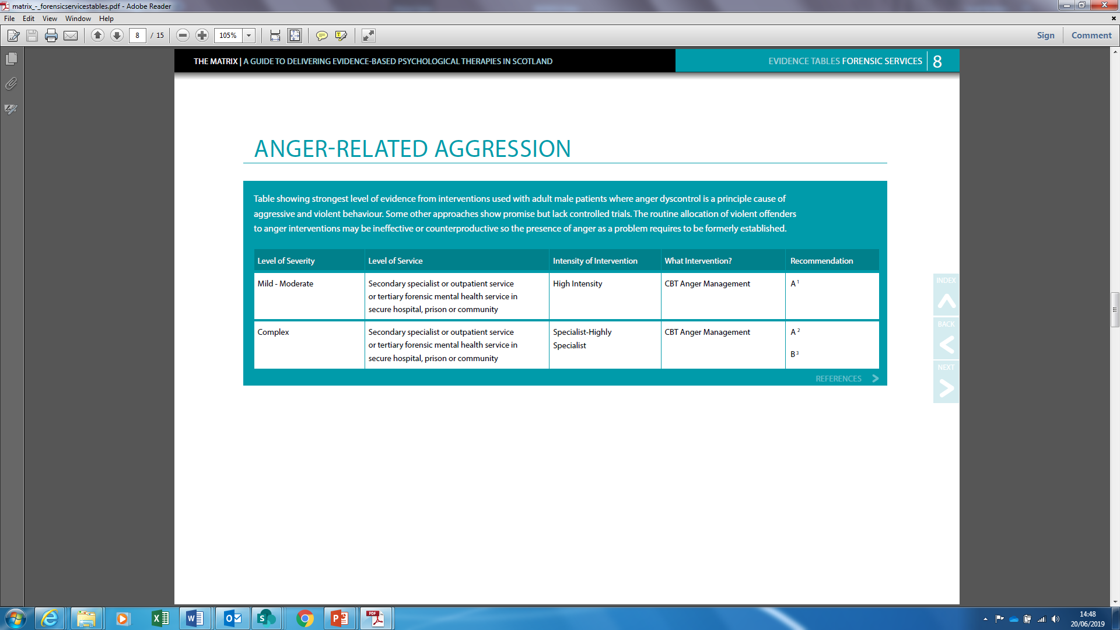
Anger Related Aggression
Notes:
Forensic Matrix guidelines are to be used along side general matrix for other conditions

Slide 6
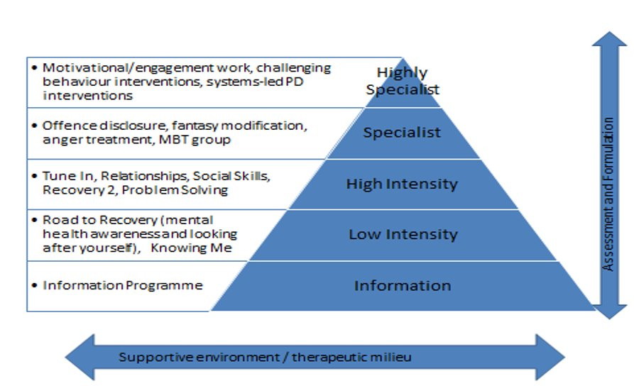
Match Stepped Care Model
Notes:
Stepped Care is a system of delivering and monitoring treatments, so that the most effective yet least resource intensive, treatment is delivered to patients first; only ‘stepping up’ to intensive/specialist services as clinically required.
“Having the right service in the right place, at the right time delivered by the right person.”

Slide 7
Forensic Matrix Group Protocols
‘On the Road to Recovery’ (LI), which comprises two distinct modules covering psychoeducation, basic coping skills and coping skills enhancement; ‘Knowing Me’ (LI), which focuses on the development of self-awareness and self-formulation skills.
‘Making Healthy Changes’ (LI), which covers underlying needs related to substance misuse/other unhealthy lifestyle choices, motivation and engagement difficulties
‘Planning for the Future’ (HI), which focuses on the consolidation of knowledge and skills gained during participation in cumulative psychological interventions, as well as covering relapse prevention skills.
‘Connections’ (HI), which focuses on the development of relationship and social skills. In the coming year, the group plan to focus on completing a ‘Problem-solving’ HI protocol which is supported by resources from the SoFMH and NHS NES.
In addition, two E Learning modules have been developed as part of the work of the group & NES:
‘See, Think, Act’, which focuses on development of knowledge and skills related to relational security
‘Working with Offenders with Personality Disorder’, which provides information about personality disorder, practical advice on how to manage people with this condition, and increases staff confidence in applying psychological principles to help improve the management of personality disordered offenders

Slide 8
Following Match-Stepped Care Model:
Forensic Matrix- Evidenced based guide to psychological therapy
Matrix Protocols- peer reviewed, formulation driven & based on underlying need
Training devised so staff can deliver protocols and a greater number of patients can access PT’s
All protocols have concurrent evaluation strategy in each service
Notes:
Part of the rational for the ‘underlying needs’ model we adopted was that previously many psychological programmes for offenders were designed to address problem behaviours, e.g. violence, or sexual violence, or drug-use. These were designed for the prison population but when implemented in forensic mental health settings, patients were ending up doing one programme after another, to address their various needs, often with no consistency in how concepts were told or the language used. There was huge overlap in the content of the different programmes. They were also based on a one-size-fits-all model, with no room for taking individual needs into account and no easy way to link a person’s learning/outstanding needs from one programme to the next. The Matrix model was designed to overcome these problems and also to allow a way of involving staff other than highly trained psychologists in therapy delivery. Before this, it was said that patients in forensic mh services were so complex that only psychologists or other highly trained therapists had the competencies to work with them. To overcome this, the important point is that the programmes target underlying needs, but the identification of needs and treatment planning is underpinned by a (risk) formulation which is carried out by a highly specialist practitioner, eg Clinical Psychologist, who retains responsibility for co-ordination, review and re-formulation based on progress in therapy and feeding this into MDT risk assessment
LI Training developed after consultation with Prof Kate Davidson Editor of Matrix
All based on review of literature for training of IPAT workers in NHS England & Wales and other psychosocial interventions course for example Thorn which was developed in 1992 in collaboration by Uni of Manchester & Institute of Psychiatry in London

Slide 9
Implementation Drivers Fixen et al 2005
Reliable Benefits
Consistent Uses of Innovations
Performance Assessment
(fidelity)
Coaching
Systems
Intervention
Competency Drivers
Facilitative
Administration
Training
Organization Drivers
Integrated & Compensatory
Integrated & Compensatory
Selection
Decision Support
Data System
Leadership Drivers
Technical
Adaptive

Slide 10
Low Intensity PT Training
Aim:
To provide a 5-day practical skills and competency-based training to:​
​
Introduce trainees to the skills necessary to deliver the agreed suite of Low Intensity (LI) psychological therapy protocols for use in forensic mental health settings, under appropriate supervision​
Develop trainees’ general level of psychological mindedness, psychological literacy and psychological skills-set

Slide 11
Intended Learning Outcomes of Training
​Demonstrate knowledge and understanding of how LI interventions have been developed and are applied to help meet the dual aims of treating mental illness/managing problem behaviours and reducing risk in forensic mental health settings.​
Demonstrate your understanding of and discuss your role in the delivery of these LI interventions ​
Feel adequately prepared to confidently and competently deliver the range of LI interventions in your area of practice - in groups or on an individual basis - under appropriate supervision​
Reflect on and identify how to use this training within your day-to-day practice

Slide 12
How do we ensure governance? “Selection”
5 Questions to Service Managers
1. Who will be responsible for the assessment of patients’ suitability for psychological interventions and how will this be assessed?
2. Who will be attending the LI training?
3. What are the clinical supervision arrangements for these LI trainees?
4. What are the plans for starting a LI group within your service, including capacity, when it will run and who will facilitate it?
5. Who will complete pre and post LI group evaluations?

Slide 13
Governance
Matrix Protocols & LI Training are supported by Governance Manual
Competency Framework
Training includes written & skills assessment that must be passed before practitioners can deliver

Slide 14
Subsequent to training- “Coaching”
Regular supervision with Highly Specialist Practitioner
CPD Day- consolidation of skills
New to Forensics Essentials of Psychological Care
Other relevant training e.g. Safety and Stabilisation, CBT for Anxiety & Core Skills
Notes:
Both SoFMH & NES have provided temporary support with supervision in some services where setting up the governance structures has proved difficult

Slide 15
So far….
Almost 300 staff trained in LI across 12 major health boards in Scotland
141 Completed TARS 2017-2019
This approach would be appropriate for a variety of staff: Average “Moderately Agree”
The training will be beneficial for staff: Average “Strongly agree”

Slide 16
LI Data 2019
 | AHP | Nursing | Psychology | SOCIAL WORK/ MHO | (blank) | Grand Total
No. Delegates | 10 | 193 | 34 | 5 | 49 | 291
Level of Security
 | Community | High | Low | Low ID | Medium | Prison | (blank) | Grand Total
No. Delegates | 29 | 29 | 93 | 3 | 48 | 38 | 51 | 291
NHS Board
 | A&A | Borders | D&G | Fife | Forth Valley | GG&C | Highland | Lanarkshire | Lothian | Tayside | TSH | Grampian | Grand Total
No. Delegates | 6 | 9 | 16 | 19 | 39 | 62 | 17 | 17 | 34 | 18 | 29 | 25 | 291

Slide 17
Pyramid Chart
Behaviour NOMAD
Patient
Outcome
Reaction & Learning TARS
Notes:
Kirkpatrick Model (1967) Hammick et al’s (2007) adaptation of Kirkpatrick’s levels following a systematic review of inter-professional education. TARS Training Acceptability Rating Scale. Derek Milne
Level of evaluation Short or long term Methods
Reaction 1 Reaction Short Therapist self-report
Learning 2a Attitudes Short Therapist self-report 2b Knowledge Short Questionnaire Written assessment 2c Skills Short Observer rated role play
Behaviour 3 Behaviour Change in practice Long Therapist reported use Therapist self-reported adherence Chart review Client or caregiver-rated adherence Observer –rated adherence and competence
Results 4 Client Outcomes Long Client or care-giver-report symptom or functioning Therapist report of functional outcomes

Slide 18
NOMAD
The NoMAD is a 23 item instrument for measuring implementation processes from the perspective of professionals directly involved in the work of implementing complex interventions in healthcare
Thus far… managers and supervisors consistently recognise the importance of LI Interventions and see the value
Barriers in terms of systems and logistics
Notes:
Normailisation Process Theory NPT created by Carl May, Elizabeth Murray, Tracy Finch, Frances Mair, Shaun Treweek, Luciana Ballini, Anne Macfarlane, Melissa Girling and Tim Rapley

Slide 19
Outcomes: is it working?
Small Scale Studies:
-Evaluation of LI in Lanarkshire & 3 FV Prisons
-LI Core Data in TSH
-Supported feasibility, acceptability & utility of LI in these settings
RCT feasibility study- Lynsey McIntosh
Notes:
Ken McMahon & Pat Cawthorne Beckford Lodge Making Healthy Changes
FV Heather Meacham & Pat Cawthorn Looking After Yourself & Knowing Me Groups

Slide 20
Outcomes, moving forward
Robust evaluation of recorded data & psychometrics
Review of efficacy of LI Training
  TARS
  NOMAD
  Patient Impact

Slide 21
Snapshot: Glasgow Forensic Service 2018-2019
Medium Secure Service:
  LI 2 Groups (OTRTR 6 & MHC LD 3)
  2 x Mindfulness
  1 Mindfulness “Taster” Group
  High Intensity (PFTF 5)
Notes:
Mindfulness group is mentioned as LI Practitioner delivers and is supervised by CP

Slide 22
Glasgow Forensic Service 2018-2019
Low Secure Service
  LI 2 Groups (MHC 6 & LAY 3 Women’s Service)
  High Intensity (TI 6)
  Highly Specialist 1 (MBT- 6)
  Community Service
  Logistical Challenges

Slide 23
Conclusions
The Forensic Matrix Group, Protocols and Training was developed in response to key SG Drivers
Almost 300 staff trained across 12 major health boards
Synergy of Psychology & Nursing
Underlying needs model represents paradigm shift away from diagnostically driven approaches
Notes:
Psychology & Nursing working together to ensure delivery of LI. Ideal way to galvanise nurses to contribute as by far the largest workforce & therefore key to ensuring delivery

Slide 24
Conclusions II
Delivery underpinned by robust governance structures
Implementation Science model ensures infrastructure in place
FMHS’s much further ahead than AMH colleagues in operationalisation of Matrix, Training of Workforce & Implementation

Slide 25
Conclusions III
Staff attrition rates are problematic, being investigated in current review
Although data is collected, lack of national aggregated figures means its hard to “evidence” impact
Concern re over focus on LI and not other levels of PI

Slide 26
Next Steps
Continue roll out of LI Training
Quality Assurance of LI Training
E-Learning Module
Impact on patients- RCT
Consider wider workforce training strategy
Consider “rolling programmes” in prisons
Trauma Informed Approach- S&S roll out
Overcoming barriers

Slide 27
Next Steps II
“Step-back” to review impact and future plans
Remember “what works”
Lack of resources for ID patients, being discussed at ID Psychology Working Group

Slide 28
Contacts

