Slide 1
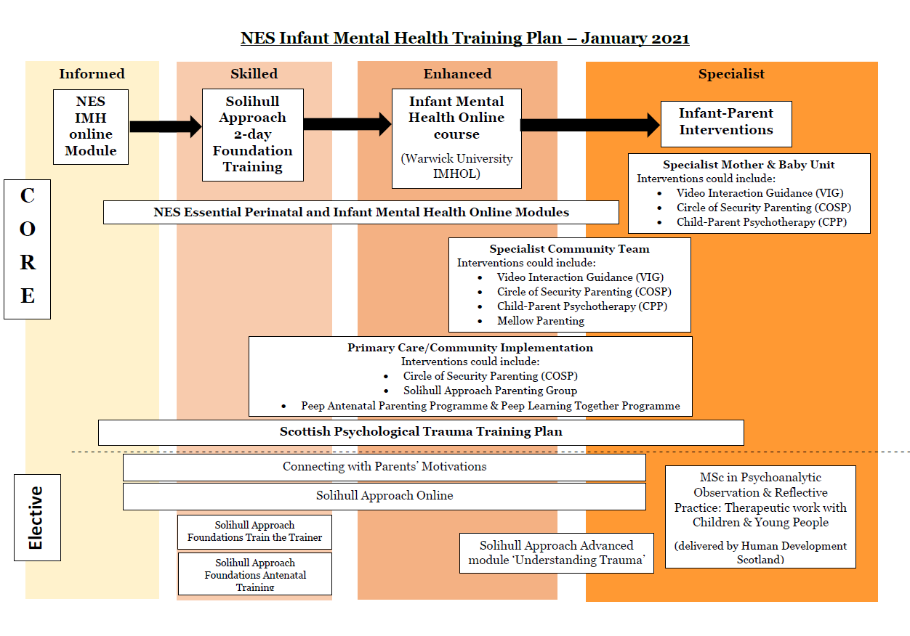
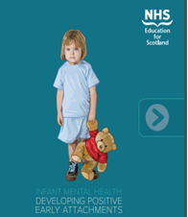
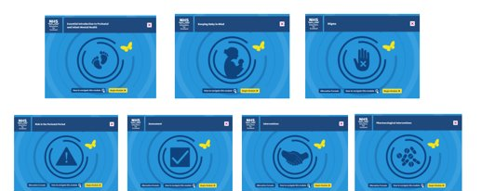
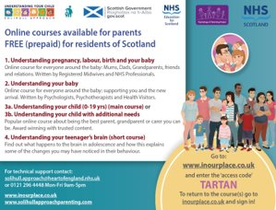
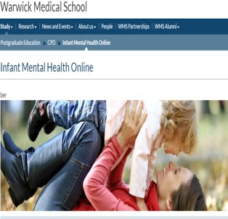
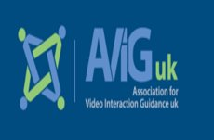
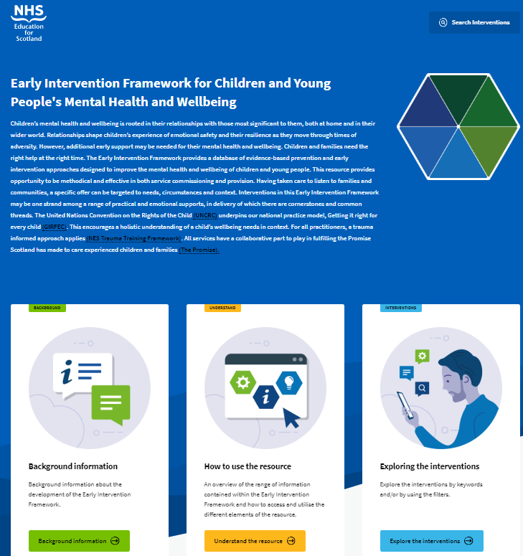
NES IMH Training Update
Introduction
In recognition of the life-long impact of the early years, Scottish Government committed to ensuring that all infants have the
best possible start in life through the development of strong relationship between parents and infants.
In order to support this initiative, a commitment to making basic Infant Mental Health training more widely available to
professionals who work with children (Commitment 8, Mental Health Strategy for Scotland 2012 – 2015) was supported by NES in
the development of the PIMH curricular framework. The framework outlines a systematic training pathway aimed at meeting the
training needs of the expanding early years workforce to support the delivery of a stepped-care delivery model.
Infant Mental Health Training Plan
NES have worked closely with the PNIMH Programme
Board to ensure that our IMH Training Plan is fully aligned with the training needs of the whole workforce, relevant to their role and setting. Access is maximised by the
general availability without prerequisite academic or
training qualification and the Solihull foundation courses and TTT, IMHOL, VIG & COSP are provided on an online basis to reduce accessibility barriers. Training is
accessible at no financial costs to individuals or services. The workstream supports continued universal, free access to Solihull Approach online courses, based on the same content as face-to-face groups, reducing barriers associated with stigma and physical accessibility. Voiceover for materials is provided to be inclusive across literacy levels with a range of available translations of the materials.
Current IMH Training Offers
NES Infant Mental Health (IMH) Interactive PDF |  | Essential Perinatal and Infant Mental Health Modules
Solihull Approach | Solihull Approach Foundation Level Training (1834 Skilled Practitioners) Solihull Approach Train the Trainer (218 Skilled Trainers Trained) Solihull Approach Online (15,616 participants) | Infant Mental Health Online (IMHOL) | Number of practitioners who have started the Warwick IMHOL Course. (389 Enhanced Practitioners)
Video Interactive Guidance (VIG) | Number of practitioners who have undertaken VIG training. (55 Enhanced/Specialist Practitioners) | - Mellow Parenting - 3 Enhanced/Specialist Practitioners - MSc in Psychoanalytic & Observation and Reflective Practice - 10 Specialist Practitioners - Circle of Security Parenting (COSP)
Additional NES Psychology IMH Work Undertaken
In agreement with Scottish Government, NES Psychology holds a role in providing consultation and support to the Family Nurse Partnership (FNP) Programme. This includes the provision of monthly 1:1 supervision to FNP supervisors as well as monthly consultation to FNP meetings and biannual CPD & network meetings. NES Psychology also provides input to the FNP education programme, specifically with regards to:
Infant Mental Health
Toddler and adolescent development
Attachment Theory
Roles of Parenting
Early Intervention Framework
- Action 3 within current MH Strategy
- Aims to increase the use of EI & Prevention
- Launched in March 2021
- Searchable database for EI&P approaches
- Information on 6 areas of implementation:
(Usability, Supports, Evidence, Fit, Capacity &
Need)
- Guided questioning, rating system and self-assessment tool for
decision making.

